Slide 1
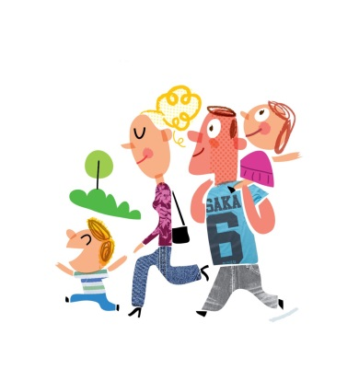
It is walk to school month –
Let’s all walk together!
Walk to School from the Village Hall on Friday 21st October!
Get your mum or dad, grandma or granddad and your dog
to join us
on Friday morning
at the Village Hall at 8:30am
and we’ll all
walk together to School.

