Slide 1
French
By Shyan and Harvey

Slide 2
Contents
Introduction
Picture gallery
Colours

Slide 3
Introduction
French is a very popular language that many people have learnt. In this PowerPoint I will teach the basic stuff like colours and numbers. Also, between England and France there is a very powerful train line which goes under the sea. This might inspire you when you go to France next time to learn more French!

Slide 4
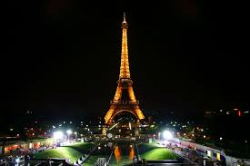
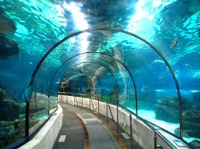
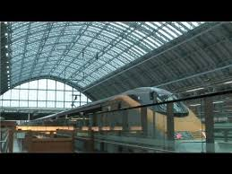
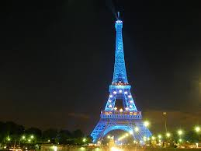
Picture gallery

Slide 5
Colours
rouge
jaune
marron
vere
rose
violet
orange
bleu

Slide 6
Numbers
1-20
1 = un 11 = onze
2 = deux 12 = douze
3 = trois 13 = treize
4 = quatre 14 = quatorze
5 = cinq 15 = quinze
6 = six 16 = seize
7 = sept 17 = dix-sept
8 = huit 18 = dix-huit
9 = neuf 19 = dix-neuf
10 = dix 20 = vingt

Slide 7
Quiz!
Now lets see how much you have remebered!

Slide 8
What is yellow
a. jaune
b. vere

Slide 9
What is three?
a. Trois
b. treize

Slide 10
What is 18?
a. dix-neuf
b. dix-huit

Slide 11
What is pink
a. rose
b. rouge

Slide 12
What is red
a. bleu
b. rouge

Slide 13
What is seven?
a. sept
b. onze

Slide 14
What is brown?
a. vere
b. marron

Slide 15
Well done for finishing the quiz!

