Slide 1
23-27 November

Slide 2
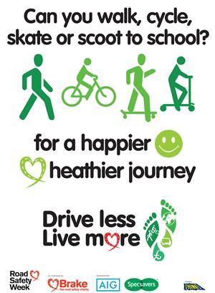
Road Safety Week is the UK's biggest road safety event, involving thousands of schools, organisations and community groups every year.

Slide 3
This year we are asking everyone to: 'drive less, live more'.
We are encouraging everyone to consider how they use roads.
It’s about making our streets safe and pleasant for everyone to use, and doing what we can to protect ourselves, people around us and our planet .
A big part of that is driving less, as little as possible, or not at all if you can: it can make a huge difference to road safety and your health, community and the planet.
Reduce car journeys and instead walk, cycle, scooter or use public transport as much as possible.
Work out how much money you'll save, calories you'll burn, and pollution you won't create.
http://roadsafetyweek.org.uk/driveless/story.html

Slide 4
Activities during the week
Every class will have different activities to do during the week. There are videos to watch, games to play on THINK! website, colouring sheets, questioners, leaflets and posters to make.

Slide 5
Be Bright, Be Seen
It is now Autumn and we have turned our clocks back one hour. The evenings are darker much earlier than they were just a months ago, the sky is sometimes gloomy and the days may become damp and foggy...
Other people using the road and pavement may find it difficult to see us. It is important that we can be seen at all times, especially when we are walking, cycling or scooting to and from school.
We could liven things up by wearing light, bright and cheery clothes when we are out and about. Fluorescent and reflective materials are the best!
Fluorescent is the bright, neon coloured material. It shows up in the daylight, at dusk and also in dull, misty weather. But it doesn’t show up in the dark.
Reflective material is special. It shows up very bright when a light shines on it. It shows up best at night. You can get reflective tape to put on your clothes and bags which will show up in car headlights.
On Wednesday, 25th November is our Hi-Vis day, so wear your fluorescent and reflective clothes to school.
Thank you for listening and stay safe!

