Slide 1
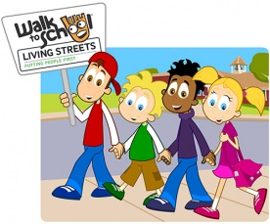
Walk to School Month
The National Walk to School campaign is organised by Living Streets, a national charity that promote walking.
The campaign aims to encourage all parents, children and young people to make walking to school part of their daily routine.
Their vision is that every child
who can walk to school does so.

Slide 2
Put on your walking shoes!
What could be better during
Walk to School Month
than actually going for a walk?
To school, from school, or all the parts in between, we need you to get out,
get walking!!!

Slide 3
Walk Once a Week
During October, we would like all of you to join in
“Walking once a Week” and we want you to record it on the travel tracker!
We will be checking how many children Walked or park and stride.
This will lead to your monthly badge, and the class with the most badges will earn a prise!
On the last week, we will organise a walk from the Village Hall to the school!

Slide 4
RAP!
OCTOBER IS WALK TO SCHOOL MONTH
SO,
WALK ONCE A WEEK
TO GET A TICK
AND EARN A BADGE AT THE END OF THE MONTH!

